Slide 1


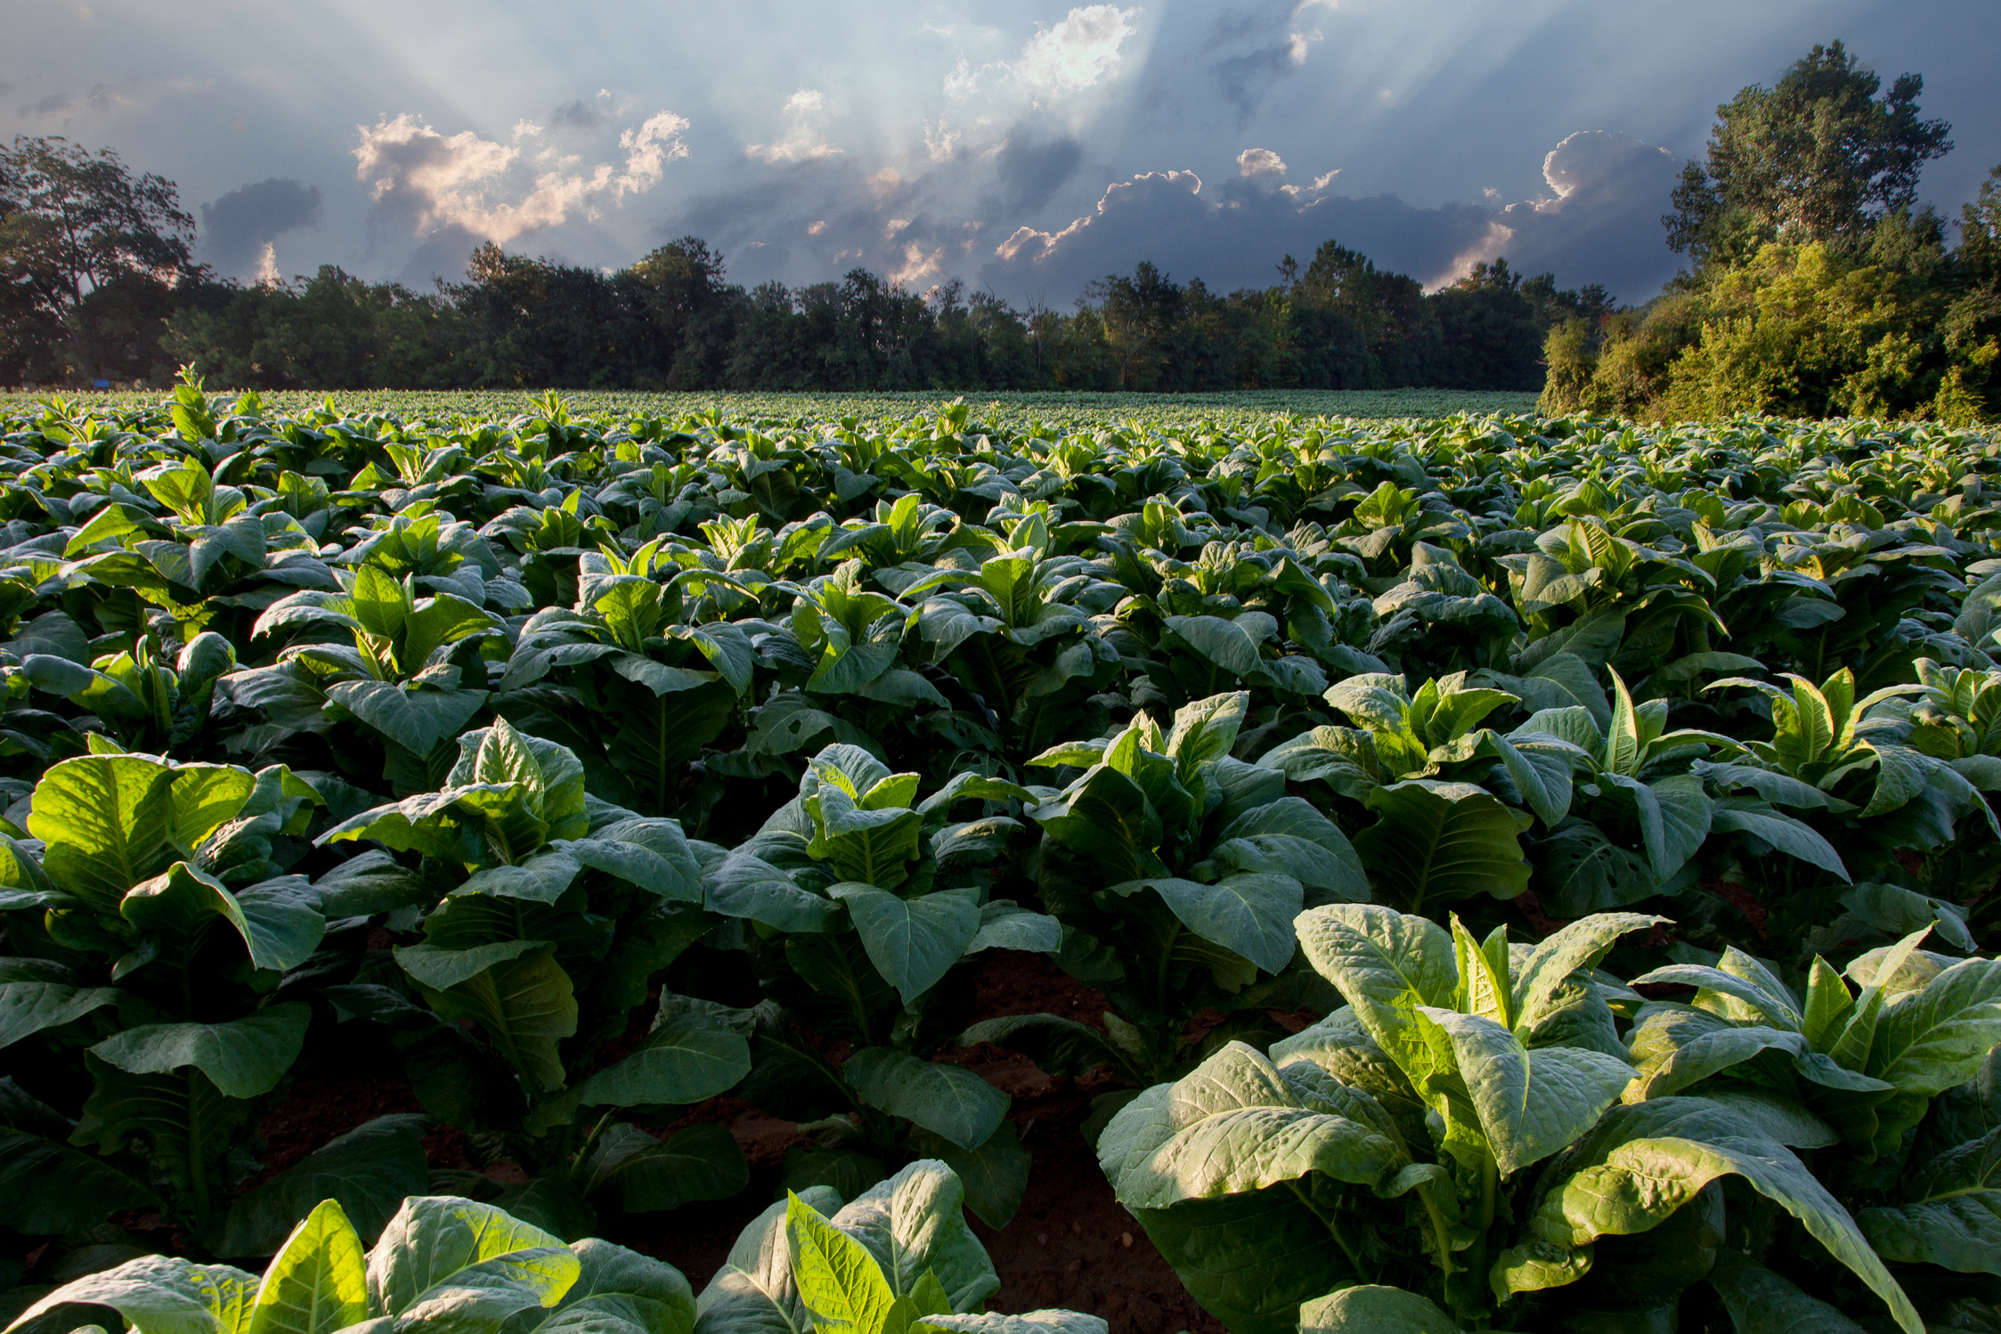
AgriWebHub
A BRIDGE BETWEEN FARMER AND CONSUMER
Presented by
Name : Disha Kaushikbhai Patel
Roll no : 252
Enrollment No : 22002171410038
Batch : A8
Branch : CS&IT

Slide 2


www.agriwebhub.com
Page 01
Introduction
AgriWebHub is an online platform connecting farmers directly with consumers, making agricultural transactions transparent and fair. Our goal is to empower farmers, prevent fraud, and ensure consumers get quality products.
OUR VISION
We envision a future where farmers sell their produce directly to consumers, ensuring fair prices and transparency.

Slide 3

www.agriwebhub.com
Page 03
Idea that lead to the concept
farmer
middlemen/broker
consumer
In traditional agricultural practices, farmers often face challenges in accessing markets directly.
Middlemen often exploit farmers by offering low prices for their produce, resulting in unfair compensation.
Consumers struggle to find reliable sources of fresh, locally sourced agricultural products.

Slide 4


www.agriwebhub.com
Page 05
Functionality
MSP Calculation: The platform calculates Minimum Support Prices (MSP). farmer have to enter cost of production and expected profit percentage.
Farmer-consumer connection : when Farmer will enter msp and corp name, it will provide list of consumers.
Consumer-Farmer connection : when consumer will enter needed amount, crop name and budget, it will provide list of farmers.

Slide 5


www.agriwebhub.com
Page 06
MERITS
DEMERITS
Direct Farmer-Consumer Connection.
Transparency.
Fraud Prevention
Fair Compensation for Farmers
Empowerment of Farmers
Limited access to technology and internet connectivity in rural areas.
Data Privacy Concerns.
Quality Assurance.

Slide 6




www.agriwebhub.com
Page 07
Future Scope
FUTURE SCOPE
Technology Integration
E-commerce
Mobile Apps and IoT
Social Impact

Slide 7
AgriWebHub
A BRIDGE BETWEEN FARMER AND CONSUMER
THANK YOU
Presented by
Name : Disha Kaushikbhai Patel
Roll no : 252
Enrollment No : 22002171410038
Batch : A8
Branch : CS&IT

